Slide 1
Exploratory Analysis of Urban Traffic Patterns
Submitted in the partial fulfillment for the award of the degree of
BACHELOR OF ENGINEERING
IN
COMPUTER SCIENCE WITH SPECIALIZATION
IN ARTIFICIAL INTELLIGENCE AND MACHINE LEARNING
Submitted by:
Mohit Choudhary:21BCS10085
Bharat Yadav: 20BCS6901
Mayank Gupta: 20BCS6892
Aayush Adhikari: 21BCS8881
Under the Supervision of:
DR.PRAMOD VISHWAKARMA
Department of AIT-CSE
DISCOVER . LEARN . EMPOWER

Slide 2

Outline
Introduction to Project
Problem Formulation
Objectives of the work
Methodology used
Experimental Setup
Future scope
Conclusion

Slide 3
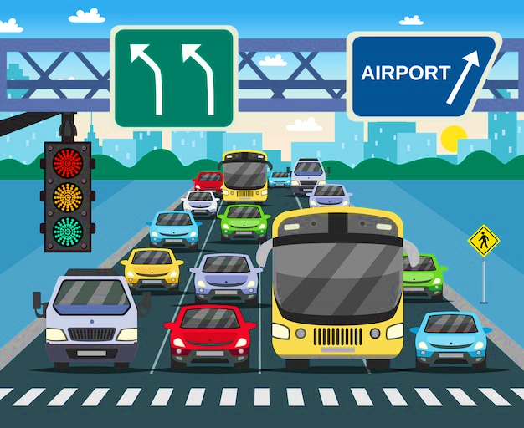
Introduction to Project
This project focuses on conducting a comprehensive analysis of urban traffic patterns within a specific geographical area.
The primary goal is to gain insights into the dynamics of urban traffic, identifying patterns, and understanding factors influencing congestion.
The analysis covers a range of aspects, including spatial and temporal variations, hotspot identification, and correlation with external factors impacting traffic.
Understanding urban traffic patterns is crucial for effective traffic management, city planning, and the development of strategies to enhance overall mobility.
Understanding urban traffic patterns is crucial for effective traffic management, city planning, and the development of strategies to enhance overall mobility.

Slide 4
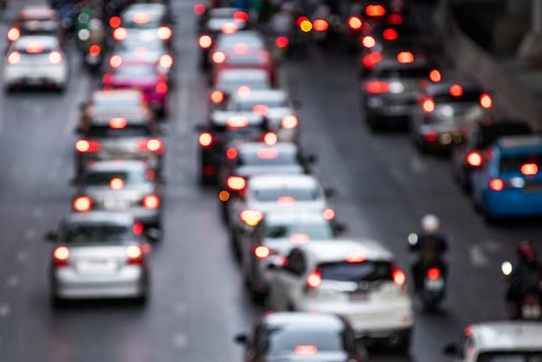
Problem Formulation
Urban areas face increasing challenges in managing traffic flow efficiently, leading to congestion and decreased mobility. This project aims to conduct an exploratory analysis of urban traffic patterns using machine learning (ML) techniques and Python programming. The goal is to extract meaningful insights from diverse traffic datasets to improve traffic management, enhance urban planning, and contribute to a more sustainable and efficient transportation system.
The specific objectives include developing predictive models for traffic patterns, creating visualizations to illustrate insights, and providing actionable recommendations for urban planners and traffic management authorities. By applying ML techniques in Python, the project aims to contribute valuable insights that can inform urban planning decisions and enhance the efficiency of traffic management systems within the targeted urban environment.

Slide 5

Objectives of the Work
Develop machine learning models to predict urban traffic patterns based on historical data, enabling the identification of peak hours, congestion points, and trends.
Utilize ML algorithms to identify congestion hotspots and analyze factors contributing to traffic issues, facilitating targeted interventions for specific areas and optimizing traffic flow.
Apply ML techniques to analyze spatial and temporal variations in urban traffic, understanding how traffic patterns evolve across different locations and timeframes.
Create visualizations using Python to effectively communicate insights and patterns to stakeholders, ensuring that the project's findings are accessible and easily understandable for informed decision-making by urban planners and traffic management authorities.

Slide 6
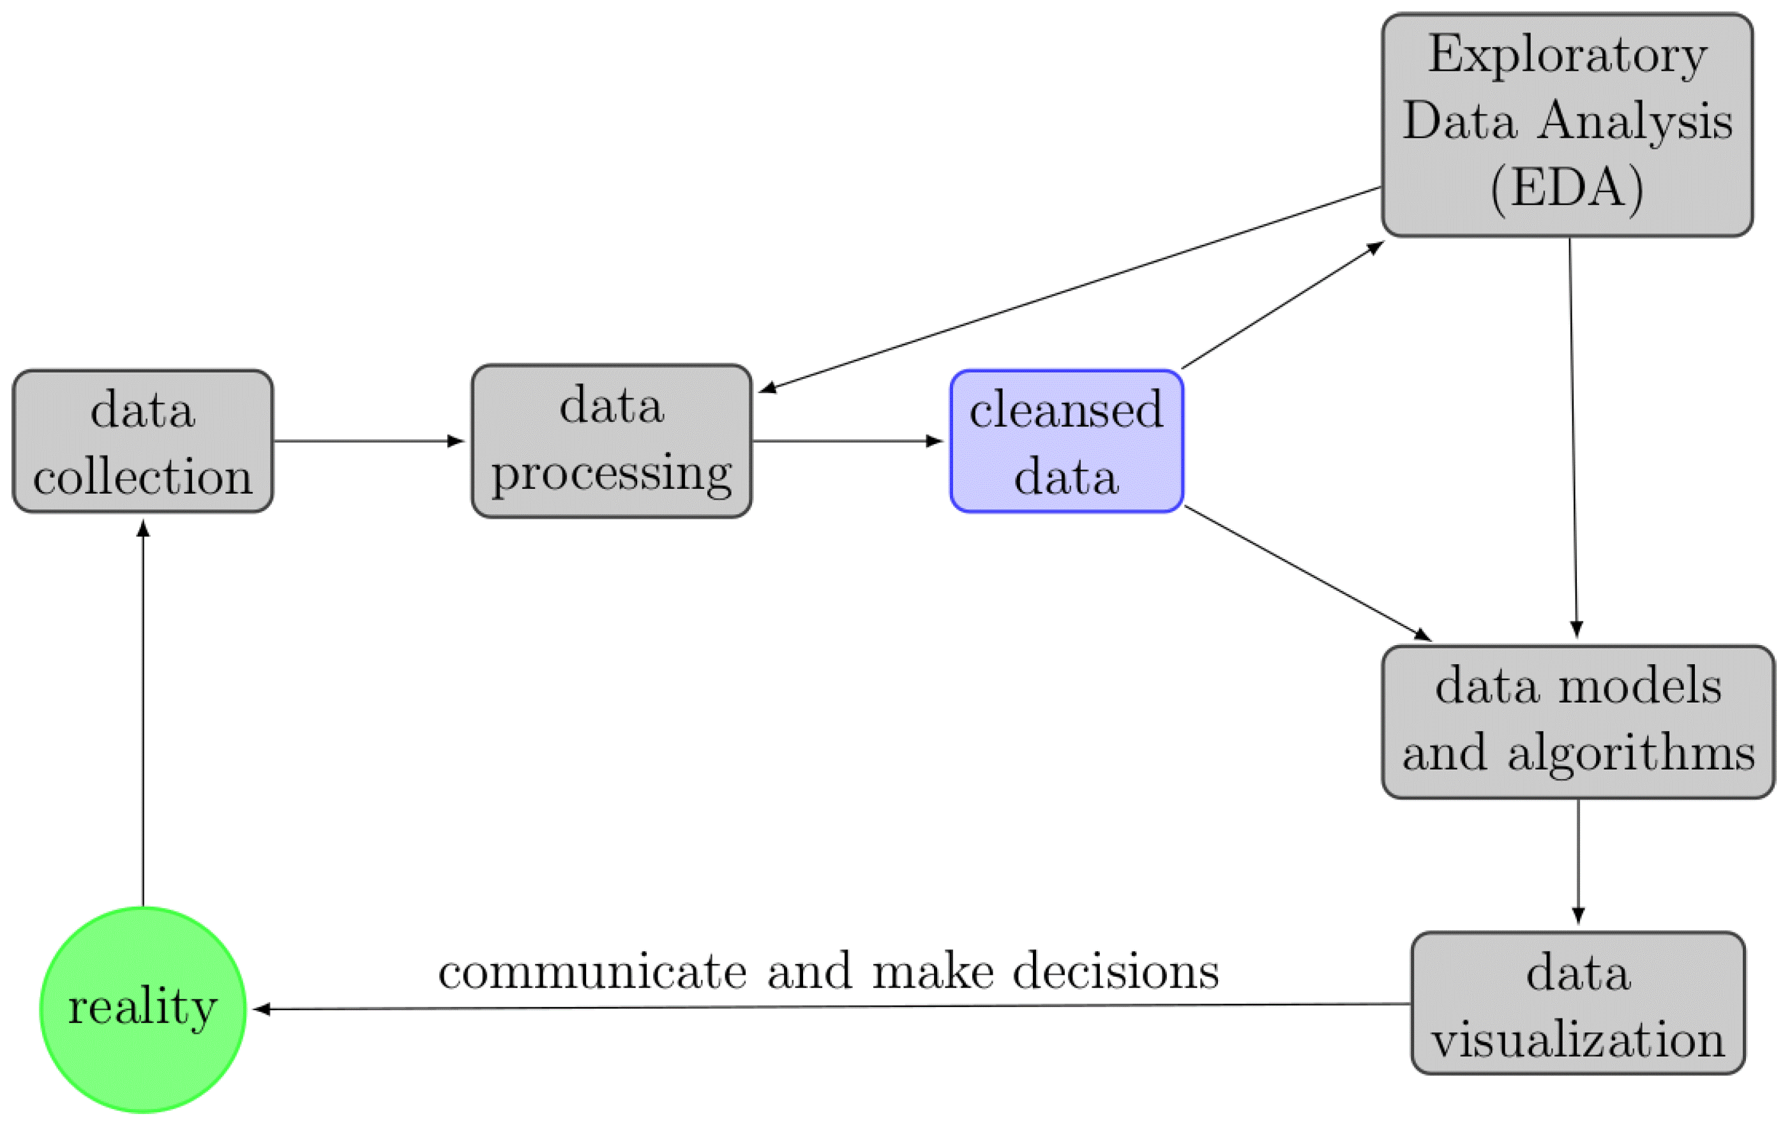
Methodology used

Slide 7
Experimental Setup
Hardware Specifications:
LAPTOP or PC with GPU and more than or equal to 4 cores.
POWER PLUG for continuous supply
RAM: 4GB or more
Peripherals: Keyboard or Mouse
Software Specifications:
Python
Jupyter Notebook or PyCharm
Tools Required:
NumPy
Matplotlib

Slide 8

Future Scope
Utilizing advanced data analytics and machine learning, future exploratory analyses of urban traffic patterns aim to predict congestion hotspots and optimize traffic flow.
Integration of real-time data from IoT devices and smart infrastructure will enhance the accuracy and responsiveness of urban traffic analyses.
The future scope involves developing proactive solutions such as dynamic traffic signal control and adaptive routing algorithms to alleviate congestion and improve overall urban mobility.
Continuous advancements in technology and the emergence of autonomous vehicles may further influence the future trajectory of urban traffic pattern explorations.

Slide 9
Conclusion
In conclusion, the Exploratory Analysis of Urban Traffic Patterns project demonstrates the potential of advanced data analytics and machine learning in predicting and managing traffic congestion. The integration of real-time data from smart infrastructure, coupled with proactive solutions like dynamic signal control, holds promise for optimizing urban mobility. As technology continues to evolve, considerations of social and environmental factors will be pivotal in crafting sustainable and equitable solutions for the dynamic challenges of urban traffic.

Slide 10
Thank you

